Slide 1
TREBLE MAKERS
Spring Concert 2024

Slide 2
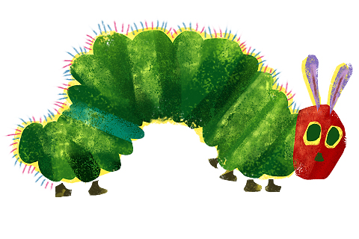
CATERPILLAR
Brown and furry, caterpillar in a hurry,
Take your walk to the shady leaf, or stalk,
Or what not, which may be the chosen spot.
No toad spy you, hovering bird of prey pass by you.
(parts 1 & 2 repeat the verse)
PART 1
Spin and die, spin and die,
To live again, to live again a butterfly.
PART 2
Spin and die, spin and die, spin and die,
To live again, to live a gain, to live again a butterfly.

Slide 3
CATERPILLAR
Brown and furry, caterpillar in a hurry,
Take your walk to the shady leaf, or stalk,
Or what not, which may be the chosen spot.
No toad spy you, hovering bird of prey pass by you.
PART 1
Pass by you, pass by you.
Caterpillar in a hurry.
PART 2
Pass by you.
Caterpillar in a hurry.

Slide 4
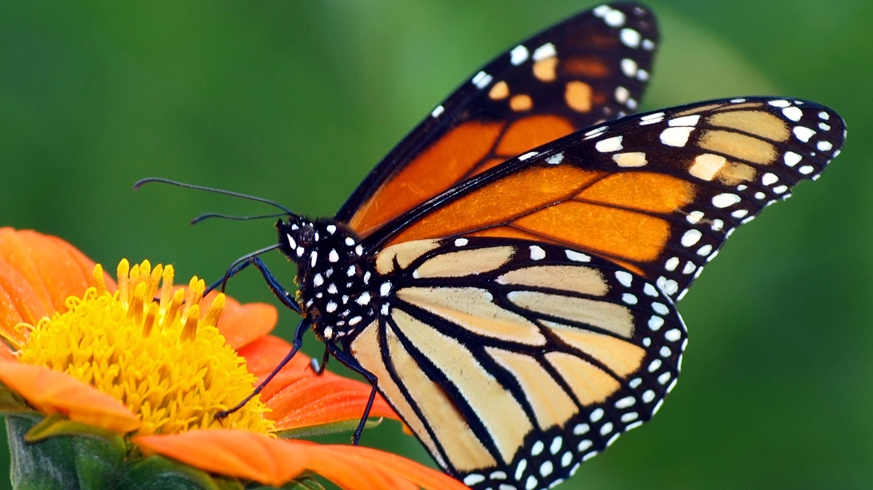
BUTTERFLY
PART 1
Fly, butterfly, so high, butterfly,
From the flower to the tree.
Go by, butterfly, in the sky for all to see.
PART 2
Fly, butterfly, so high, butterfly,
Darting quickly ‘round the bend.
Oh my, butterfly!
Where will the journey end?

Slide 5
BUTTERFLY
PART 1
Flutter, butterfly. Flutter, butterfly, so lovely.
Flutter, butterfly. Flutter, butterfly, so free.
Flutter, butterfly. Better flutter by.
PART 2
Flutter, butterfly. Flutter, butterfly.
Flutter, butterfly. Flutter, butterfly.
Flutter, butterfly. Better flutter by.

Slide 6
BUTTERFLY
PART 1
I wanna fly in the meadow as you do.
I’ll try, butterfly, but I cannot fly like you.
I wanna try to emerge from my cocoon.
And I, butterfly, wanna make it happen soon.
PART 2
I, butterfly, wanna fly, butterfly,
In the meadow as you do.
Try, but I cannot fly like you.
I, butterfly, wanna try, butterfly,
to emerge from my cocoon.
I wanna make it happen soon

Slide 7
BUTTERFLY
PART 1
Flutter, butterfly. Flutter, butterfly, so lovely.
Flutter, butterfly. Flutter, butterfly, so free.
Flutter, butterfly. Better flutter by.
PART 2
Flutter, butterfly. Flutter, butterfly.
Flutter, butterfly. Flutter, butterfly.
Flutter, butterfly. Better flutter by.

Slide 8
BUTTERFLY
PART 1
I will fly with the wind beneath my wing.
Stand by, butterfly, I can do anything!
Flutter, butterfly. Flutter, butterfly.
Goodbye. Goodbye. Flutter by.
PART 2
I, butterfly, will fly, butterfly,
with the wind beneath my wing.
Stand by, butterfly, I can do anything!
Flutter butterfly. Flutter, butterfly.
Goodbye, butterfly.
Goodbye, butterfly. Flutter by.

Slide 9
ALL THE PRETTY LITTLE HORSES
Hush-a-bye, don’t you cry,
Go to sleepy little baby.
When you wake, you shall have
All the pretty little horses.
PART 1:
Hush-a-bye, don’t you cry,
Go to sleepy little baby.
PART 2:
When you wake, you shall have
All the pretty little horses.

Slide 10
ALL THE PRETTY LITTLE HORSES
PART 1:
Dapples and grays,
PART 2:
(Start 1st) Blacks and bays,
ALL:
Coach and six a-little horses.
repeat

Slide 11
ALL THE PRETTY LITTLE HORSES
PART 1:
Horses, all the horses.
PART 2:
All the pretty little horses, pretty little horses.
ALL:
Hush, my baby, don’t you cry,
I will sing you a lullaby, lullaby.
Hush, my baby, safe from harm,
While I cradle you on my arm.

Slide 12
ALL THE PRETTY LITTLE HORSES
PART 1:
Hush-a-bye.
PART 2:
Hush-a-bye, don’t you cry,
ALL:
Go to sleepy little baby.
PART 1:
When you wake, you shall have
PART 2:
When you wake
ALL:
All the pretty little horses.

Slide 13
ALL THE PRETTY LITTLE HORSES
PART 1:
Dapples and grays,
PART 2:
(Start 1st) Blacks and bays,
ALL:
Coach and six a-little horses.
repeat

Slide 14
ALL THE PRETTY LITTLE HORSES
PART 1:
Horses, all the horses.
Hush-a-bye, don’t you cry,
Go to sleep baby.
PART 2:
All the pretty little horses.
Pretty little horses.
Hush-a-bye, don’t you cry,
Go to sleep baby.

