Slide 1
WFE Chorus
Spring Concert 2024

Slide 2
|
|
|
|
|
|
|
|
|
|
THE SPIDER
Music by Greg Gilpin
Words by Jane Taylor

Slide 3
|
|
|
|
|
|
|
|
|
|
PART 1 & 2:
(gasp) 2x
Oh, look at that great big ugly spider.
What a frightful creature as ever can be!
Oh, look at that great big ugly spider.
I wish that it would not come crawling to me.

Slide 4
|
|
|
|
|
|
|
|
|
|
PART 1:
Oh, look! A great big ugly spider.
Oh, look! A creature scary to see.
Oh, look! A great big ugly spider.
PART 2:
Oh, look at that great big ugly spider.
What a frightful creature as ever can be!
Oh, look at that great big ugly spider.
I wish that it would not come crawling to me.

Slide 5
|
|
|
|
|
|
|
|
|
|
Indeed, yes, indeed, I will venture to say,
The poor thing will try to keep out of my way;
For after the fright, and the fall, and the pain,
It as much more occasion than me to complain.

Slide 6
|
|
|
|
|
|
|
|
|
|
PART 1:
Oh, look! A great big ugly spider.
Oh, look! A creature scary to see.
Oh, look! A great big ugly spider.
PART 2:
Oh, look at that great big ugly spider.
What a frightful creature as ever can be!
Oh, look at that great big ugly spider.
I wish that it would not come crawling to me.

Slide 7
|
|
|
|
|
|
|
|
|
|
Now look, it has gone to its home.
Do you see the delicate web it has spun in the tree?
So here is a lesson for me and for you:
Come learn from this spider what patience can do!

Slide 8
PART 1:
Oh, look! A great big ugly spider.
Oh, look! A creature scary to see.
Oh, look! A great big ugly spider.
I wish that it would not come crawling to me.
PART 2:
Oh, look at that great big ugly spider.
What a frightful creature as ever can be!
Oh, look at that great big ugly spider.
I wish that it would not come crawling to me.
|
|
|
|
|
|
|
|
|
|

Slide 9
|
|
|
|
|
|
|
|
|
|
PART 1:
I wish that it would not come crawling to me!
(gasp)
PART 2:
I wish that it would not come crawling to me.
(gasp)

Slide 10
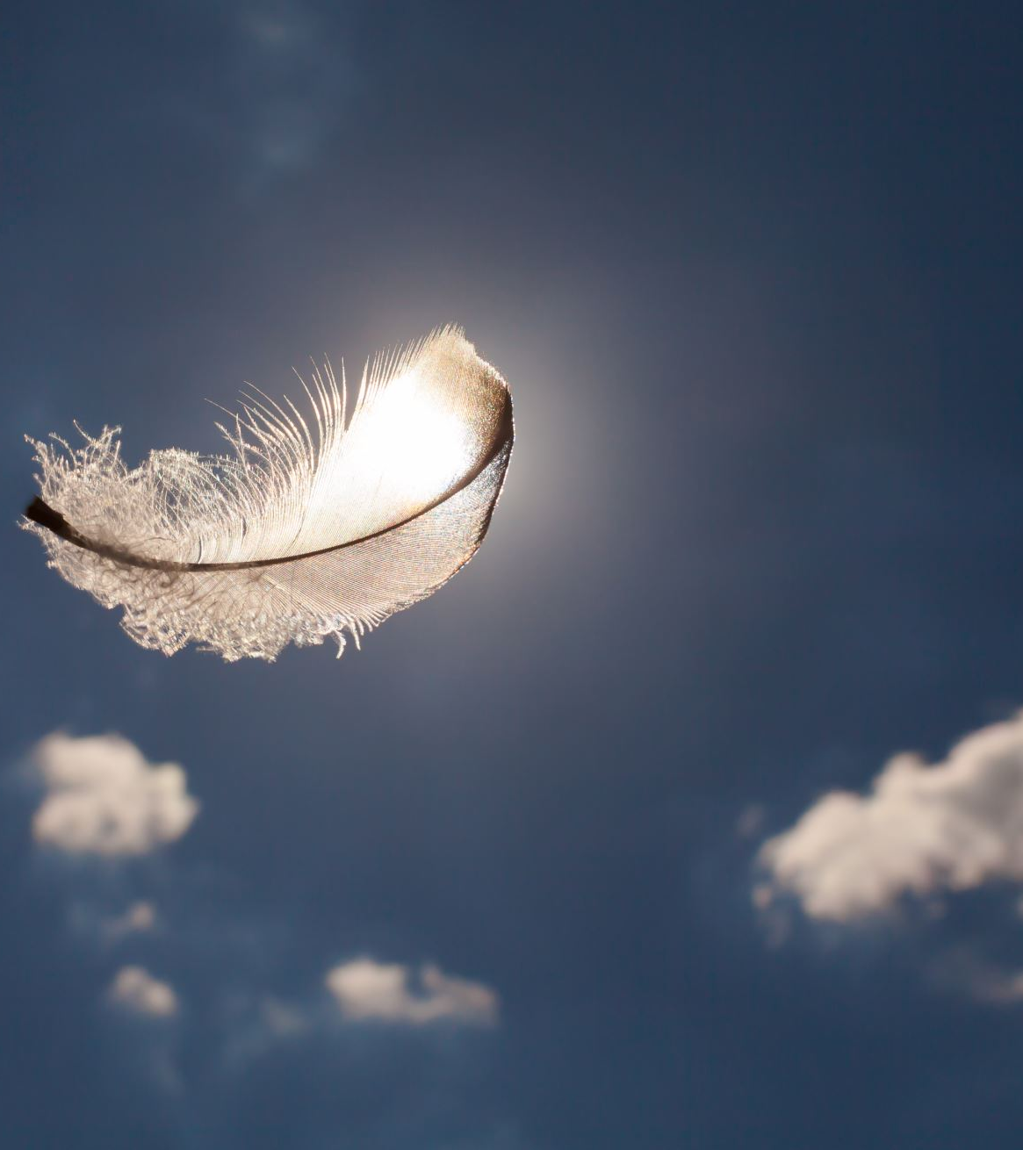
Hope Is The Thing With Feathers

Slide 11
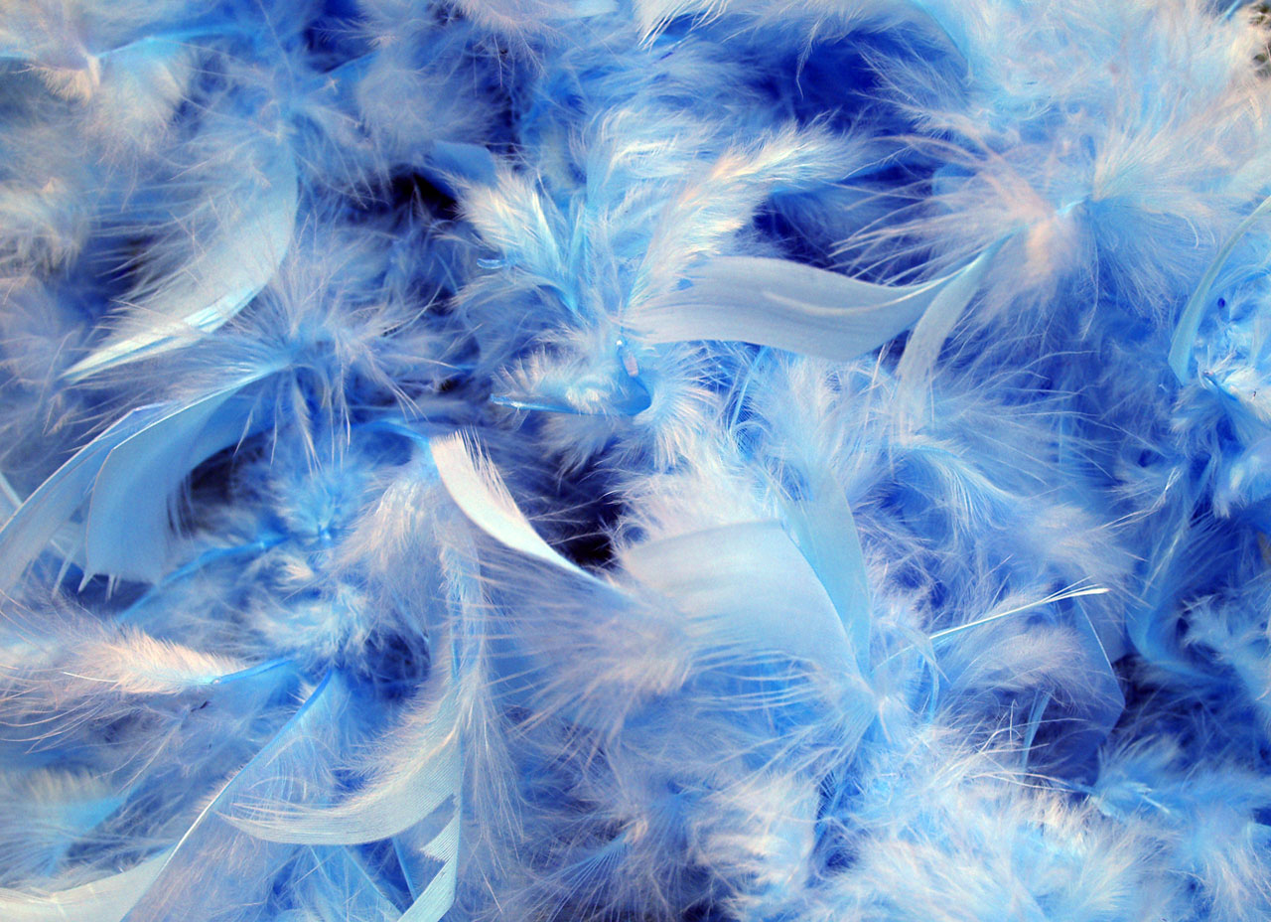
Hope is the thing with feathers___that perches in the soul,
And sings the tune without the words and never stops at all.
Hope is the thing with feathers___that perches in the soul,
And sings the tune without the words and never stops at all.

Slide 12
PART 1:
And sweetest in the gale is heard
and sore must be the storm
That could abash the little bird that kept so many warm.
PART 2:
Oo ______________
Oo ______________
That could abash the little bird that kept so many warm.

Slide 13
PART 1:
*Hope is the thing with feathers
That perches in the soul,
That sings the tune without the words
and never stops at all
PART 2:
Hope is the thing with feathers
That perches in the soul,
That sings the tune and never stops at all

Slide 14
PART 1:
Hope is the thing with feathers,
It’s in the soul and sings the tune
without the words
and never stops at all
PART 2:
*Hope is the thing with feathers
That perches in the soul,
And sings the tune without the words
and never stops at all

Slide 15
PART 1:
I’ve heard it in the chilliest land,
And on the strangest sea,
Yet never in extremity it asked a crumb of me.
PART 2:
Oo ______________
Oo ______________
Yet never in extremity it asked a crumb of me.

Slide 16
PART 1:
Hope is the thing with feathers,
It’s in the soul and sings the tune
without the words
and never stops at all
PART 2:
*Hope is the thing with feathers
That perches in the soul,
And sings the tune without the words
and never stops at all

Slide 17
PART 1:
And never stops at all.
Hope is the thing with feathers.
It never stops at all!
PART 2:
And never stops at all.
Hope is the thing with feathers.
It never stops at all!

Slide 18
Woodchuck
By Mark Burrows

Slide 19
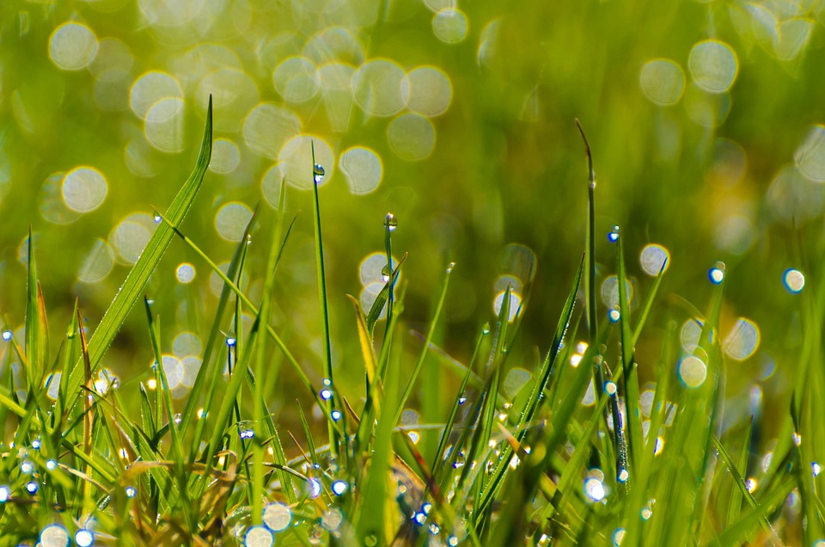
PART 1:
Woodchuck could chuck wood.
Woodchuck could chuck wood.
Woodchuck could chuck wood.
Woodchuck could chuck wood.
PART 2:
Woodchuck could chuck wood,
Woodchuck could chuck, could chuck wood.
Woodchuck could chuck wood,
Woodchuck could chuck, could chuck wood.

Slide 20
BOTH: (body percussion)
Stomp stomp pat pat pat
Stomp pat clap pat
Stomp stomp pat pat pat
Stomp pat clap

Slide 21
BOTH:
How much wood could a woodchuck chuck
If a woodchuck could chuck wood?
Just as much as a woodchuck could
If a woodchuck could chuck wood.

Slide 22
BOTH: (body percussion)
Stomp stomp pat pat pat
Stomp pat clap pat
Stomp stomp pat pat pat
Stomp pat clap

Slide 23
PART 1:
How much wood could a woodchuck chuck
If a woodchuck could chuck wood?
Just as much as a woodchuck could
If a woodchuck could chuck wood.
PART 2:
How much wood could a woodchuck chuck
If a woodchuck could chuck wood?
Just as much as a woodchuck could
If a woodchuck could chuck wood.

Slide 24
PART 1:
Woodchuck could chuck wood.
Woodchuck could chuck wood.
Woodchuck could chuck wood.
Woodchuck could chuck wood.
PART 2:
Woodchuck could chuck wood,
Woodchuck could chuck, could chuck wood.
Woodchuck could chuck wood,
Woodchuck could chuck, could chuck wood.

Slide 25
BOTH: (body percussion)
Stomp stomp pat pat pat
Stomp pat clap pat
Stomp stomp pat pat pat
Stomp pat clap

Slide 26
ALL: (in a round with parts 1,2 and 3)
How much wood could a woodchuck chuck
If a woodchuck could chuck wood?
Just as much as a woodchuck could
If a woodchuck could chuck wood.
How much wood could a woodchuck chuck
If a woodchuck could chuck wood?
Just as much as a woodchuck could
If a woodchuck could chuck wood

Slide 27
ALL TOGETHER:
How much wood could a woodchuck chuck?
Stomp stomp pat pat pat stomp pat clap
If a wood chuck could chuck
PART 1:
Wood chuck could chuck wood.
Wood chuck could chuck wood?
PART 2:
Woodchuck could chuck wood,
Woodchuck could chuck, could chuck wood?

Slide 28
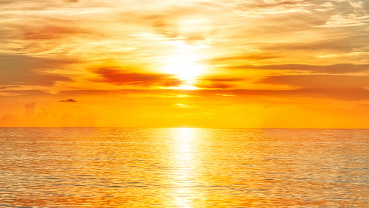
SHINE!
This Photo by Unknown Author is licensed under CC BY-SA-NC

Slide 29
I write my story my own way
I think about the person I can be someday.
I trust my heart to be my guide.
With dreams so bright that I can cast my fears aside.

Slide 30
We’ve come this far and still we know,
There’s even farther we can go
When we lead with love, and let it show!

Slide 31
Watch us shine, hear us roar
See us smile as we soar!
Feeling proud, feeling strong
Feeling love for each other, knowing we belong.

Slide 32
Just like a firefly at night.
I travel through the dark by making my own light.
And when it’s still too dark to see,
We’ll join together and we’ll shine in harmony.

Slide 33
And when our light begins to grow
From miles away you’ll see the glow
When we lead with love and let it show

Slide 34
Watch us shine, hear us roar
See us smile as we soar!
Feeling proud, feeling strong
Feeling love for each other, knowing we belong.

Slide 35
We are the promises we make
We are the dreams we have,
The chances that we take.

Slide 36
Watch us shine, hear us roar
See us smile as we soar!
Feeling proud, feeling strong
Feeling love for each other, knowing we belong.

Slide 37
I Love the Rain
Bert Stratton/Vicki Tucker Courtney

Slide 38
I love the rain.
I love the rain.
The stirring sounds of droplets on the roof
And watching rivers running down my window pane is proof.
I love_______ the rain.
Part 1:
I love the rain. I love the rain.
The timeless way it falls upon the earth
And stops the world just long enough to satisfy my thirst.
(sing 1st here) I love the rain
Part 2:
(sing 1st) I love the rain. I love the rain
The timeless way it falls upon the earth, the way it falls
And stops the world just long enough to satisfy my thirst.
I love the rain.

Slide 39
Part 1:
(sing 1st here) It sweeps the dust of doubt away
It wipes the tears that cloud my day
And fills my heart with calmness.
Part 2:
And sings a song of promise.
It wipes the tears that cloud my day
And fills my heart with calmness.

Slide 40
Part 1:
I love the rain. I love the rain.
Then suddenly it stops as it began
And now I see a rainbow and I know I’m me again.
And that is why I love the rain.
Part 2:
(sing 1st) I love the rain. I love the rain
Then suddenly it stops as it began, as it began.
And now I see a rainbow and I know I’m me again.
And that is why I love the rain.

